Slide 1
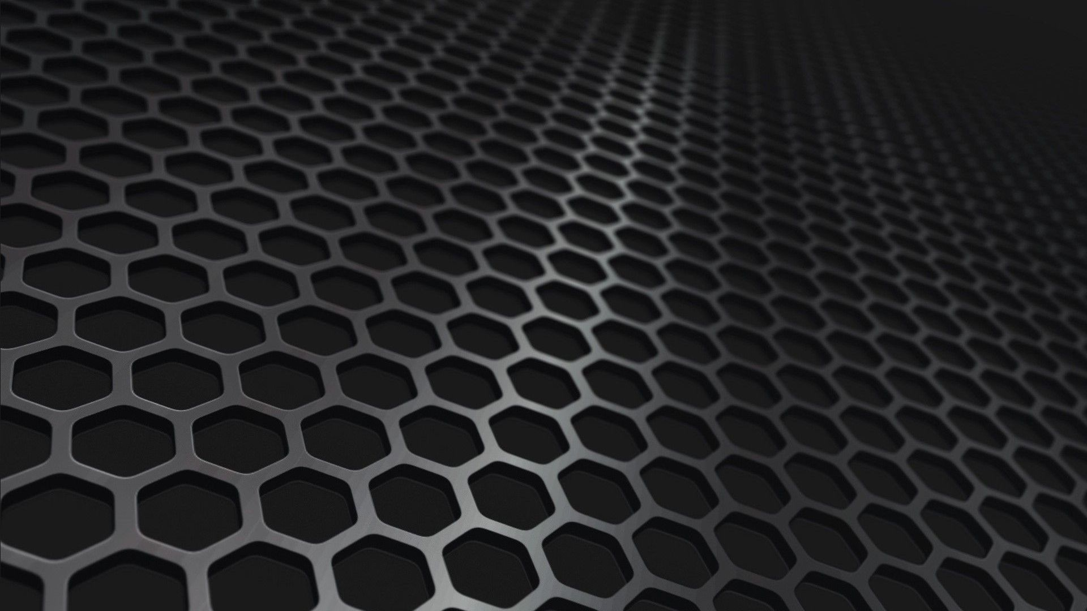
SKDP
The Symmetric Key Distribution Protocol
A scalable, lightweight, high-security symmetric communications protocol
QRCS – Leader in Post Quantum Solutions

Slide 2
The challenges ahead
Key distribution, is one of the most challenging problems in cryptography. The private information we send over the public internet, must be secured, as the internet has now become a primary tool in global commerce, and a communications infrastructure connecting people everywhere. Financial institutions use cryptography to encrypt sensitive financial information traversing the public internet. Companies and individuals use the internet for private communications. Most of the cryptography used in these communications is on the verge of becoming obsolete, threatened by a powerful new technology; quantum computers.

Slide 3
The state of the industry
The emergence of quantum computers has long been understood to pose a serious threat to the integrity of our secure communications systems, but the industry has been very slow to act. In 2019, NIST, began a competition to replace asymmetric ciphers and signature schemes, that will be broken once quantum computers are built to scale. This process is expected to take 5 years, ending in 2023, but transitioning all of the worlds infrastructure will take much longer, ten years or more. The result is that quantum computers capable of breaking our crypto-systems will exist long before that transition has completed, representing a colossal failure by the cryptographic community, to address a threat they knew was coming for more than 20 years.

Slide 4
The monetization of security
This failure to act, is in large part due to the increasing monetization of cryptography and the world’s security systems. There has been a constant push towards computationally cheap algorithms, fueled by web-based industries, who consider cryptography primarily as a business cost. These industry players have become the driving force in the development of new cryptographic technologies, that favor performance over long-term security. They drive the development cycle, and are over-represented in standards bodies. The result is that even the systems we are developing now as post-quantum resistant, may not be strong enough to guarantee real long-term security.

Slide 5
The emerging threat
Quantum computers are not the only threat to our security, and in fact, the development of artificial intelligence, will pose an even greater threat to these systems in the future. Asymmetric cryptography is based upon hard mathematical problems, but these problems are constantly being challenged by breakthroughs in mathematics and technology. In this century, we will achieve strong AI, a form of machine intelligence with reasoning capabilities, that can evolve independent of it’s original programming. This new form of intelligence will quickly eclipse human cognitive capabilities, and many of the seemingly intractable mathematical problems as we understand them today, could be solved by these machines.

Slide 6
Is there a better solution?
The NIST Post Quantum competition, now in its third stage, appears to be favoring lattice based ciphers and signature schemes. There is a great deal of skepticism among senior cryptologists, that LWE based cryptography is not well understood, evidenced by repeated breaks and reductions in security over the last 5 years. More reliable mechanisms like code-based ciphers, and hash-based signature schemes are being sidelined, because they are more computationally expensive. It seems likely that in 20 years, perhaps less, we will be right back where we started, searching for replacements for our cryptographic infrastructure. There is however, another solution entirely, one that can offer true long-term security, regardless unexpected leaps in technology.

Slide 7
Symmetric crypto-systems
Symmetric based crypto-systems, ones which establish a communications channel using only pre-shared secrets and symmetric cryptography, have been used in our communications systems for decades. Some examples are DUKPT, which stores a secret on a debit card, or SSH, used in remote access and as the core encryption protocol in many financial transfer systems. Though using pre-shared secrets is not practical in some instances like web browsing, it is widely used in financial transactions, and if done properly and using appropriately strong cryptographic primitives, symmetric based systems can be made unbreakable, perhaps indefinitely.

Slide 8
AES is not future secure
A related subkey attack, in which the authors broke 11 of 14 rounds of AES-256, the authors stated:
“While neither AES-128 nor AES-256 can be directly broken by these attacks, the fact that their hybrid (a reduced rounds version) can be broken with such a low complexity raises serious concern about the remaining safety margin offered by the AES family of cryptosystems.”
That was more than 10 years ago, and nothing has changed. There is the misconception that a continuous public effort to analyze AES is underway, this is simply not that case. However, intelligence agencies, that have unlimited resources, and employ the best cryptanalysts, mathematicians, and engineers in the world, have been studying it extensively, and breaking AES represents the pinnacle of their efforts.

Slide 9
Restoring balance
Rijndael, the symmetric cipher used by AES, uses a fast and efficient transformation function. There has been billions of dollars in investment made into embedding these instructions onto CPU hardware. The weaknesses in AES however, are not with the transform itself, but with the key schedule, a key expansion function that turns a small input key into a larger array of round keys used by the transform function. The Rijndael key schedule is differentially-weak, deriving most of the output from an XOR of two previous round keys. In the authenticated symmetric stream cipher RCS, we have replaced this function with cSHAKE, one of the strongest key expansion functions available, and increased the number of transformation rounds from 14 to 22, restoring the security margin.

Slide 10
True 512-bit security
RCS is capable of using 512-bit cipher keys, doubling the security margins once offered by AES. The 512-bit implementation uses 30 transformation rounds, and both versions can use a software based, or AES-NI based implementation of the cipher. RCS is an authenticated stream cipher using an AEAD configuration: every packet’s payload and header are authenticated in SKDP using KMAC, the Keccak based MAC function, in either 256, or 512-bit authentication modes. This makes RCS one of the strongest and most cryptographically secure ciphers in the world. This type of forward thinking is what we need, if we are to achieve real long term security, in the face of momentous technological change.

Slide 11
Aging alternatives
Protocols like SSH and its derivatives, are used throughout the communications spectrum, from remote terminals, remote control of machines, even as the core of critical financial software. SSH is over-engineered, as often happens, attempts to incorporate the protocol into a wide range of applications, causes the introduction of unnecessary complexity and unanticipated weaknesses. SKDP on the other hand, is a simple, point-to-point communications protocol, a base upon which other more complex protocols can be built. That simplicity and separation of function, allows for a vast range of applications of this technology, from remotely controlled machinery, commodity trading systems, secure software updates, even a consumer messaging system.

Slide 12
Forward secrecy
Aside from the fact that SKDP employs far stronger cryptography, it was designed with another important security feature; forward secrecy. Forward secrecy means that even if the pre-shared key has been captured, it alone can not be used to decrypt any previous message stream. Every communications session established with SKDP, uses a unique, ephemeral set of session keys, and capturing the pre-shared key, does not reveal any information about past sessions. Only if the master key is captured, and every stream is recorded start to finish, is the system compromised, the same weakness of any cryptographic communications system, including ones derived from asymmetric methods.

Slide 13
Massive scalability
SKDP was designed to be flexible, it can be used in a point-to-point encrypted tunnel, or in a multi-tiered network, with millions of clients accessible through a hierarchal network of branch servers. SKDP can use a master-server-client distribution paradigm, in which a master server distributes pre-shared keys to a server layer, and each server distributes pre-shared keys to a near unlimited number of clients. Servers can use a master node, to communicate between clients on other branches, creating a network that could feasibly scale to billions of devices from a single set of master keys. SKDP is just as adept at client-server communications, and can be used as an encrypted service layer, a tunnel, or a secure communications layer in a more complex protocol.

Slide 14
Fast and light-weight
SKDP is ideal for devices with memory and hardware constraints. It is a relatively simple mechanism, comprised of a strong symmetric cipher, and the Keccak family of functions. Keccak is used to encrypt and authenticate the initial key exchange. This exchange, a full duplexed bi-directional exchange of session keys, is performed using Keccak XOF and MAC functions, and represents only a small fraction of the resources that would be required for a similar key exchange done with asymmetric signature schemes and ciphers. The symmetric cipher RCS, in 256-bit mode, is only about 30 percent more expensive than AES-256, while providing far stronger security.

Slide 15
Conclusion
The owner of this technology will be able to license its use, and given its emphasis on high-security, it has many applications in government and military settings, and many commercial applications as well.
SKDP is a very powerful and flexible tool, and the owner of this technology, will be well-equipped to counter future threats to our information security.

Slide 16
Thanks!
Any questions?
Quantum Resistant Cryptographic Solutions
John G. Underhill
Ottawa, Ontario
1-613-699-3537
support@qrcs.com

